Slide 1

RAINFALL PATERNS IN GHANA

Slide 2
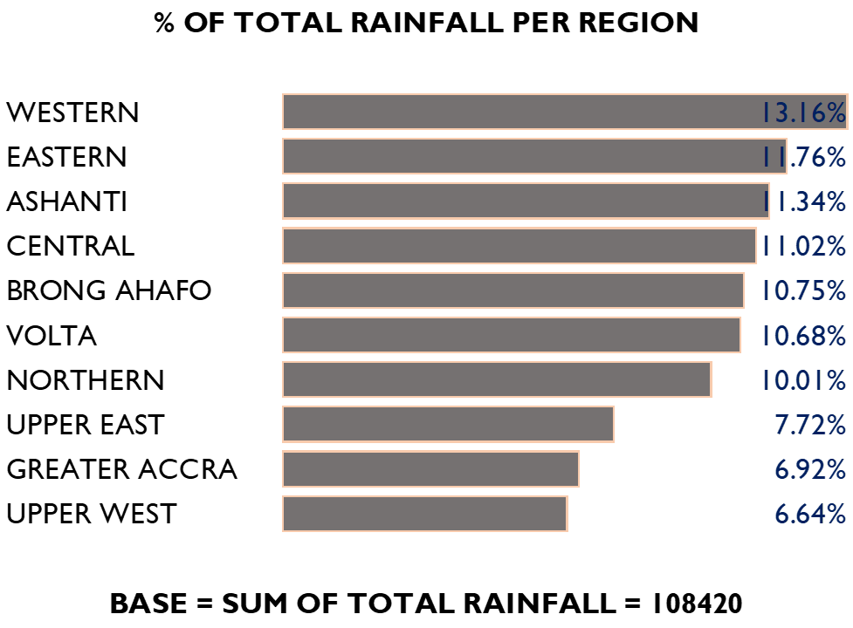
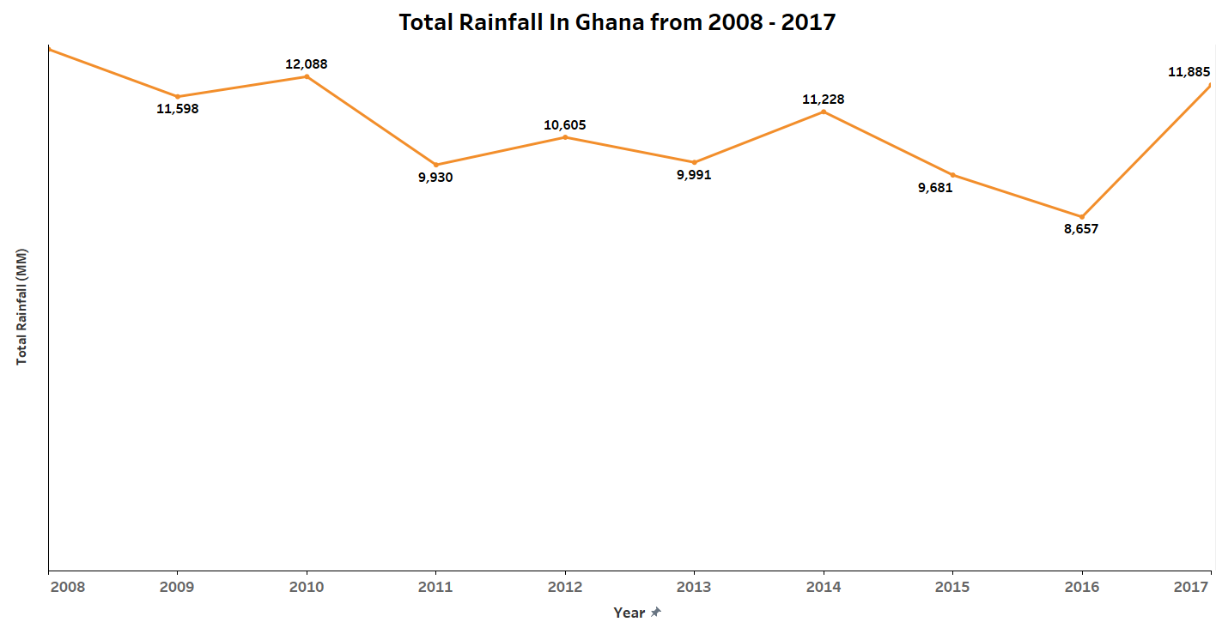
Total rainfall in Ghana

Slide 3
PRODUCTION ESTIMATES

Slide 4
ANALYSIS OF CROPS

Slide 5
MACHINE LEARNNG MODEL

Slide 6
Ml parameters
The model uses an GradientBoostingRegressor from Scikit learn with the following parameters.
n_estimators=50
criterion='mse'
min_samples_split=56
min_samples_leaf=4
alpha=0.5
tol=0.01
Mean Squared Error: 3.84

Slide 7
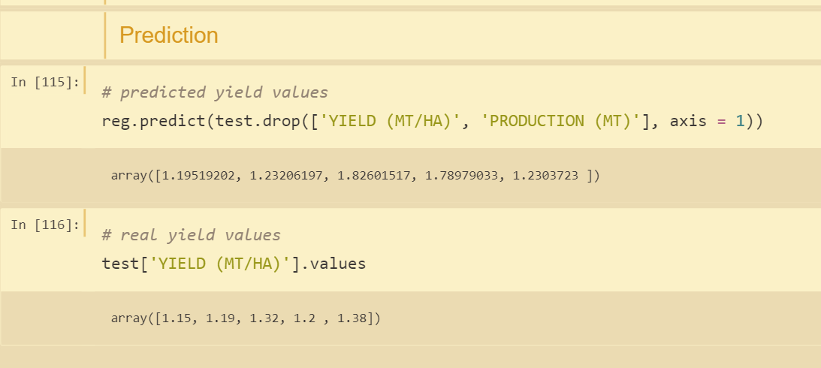
Ml PREDICTIONS

Slide 8
POWER BI DASHBOARD

Slide 9
DASHBOARD DETAILS
There are two filters
Region
Year
The following charts have drill throughs:
Production By Crop
Yield By Crop

